Slide 1




INSTRUCTION: Download this Slide and then Edit!
Beyond Byte
Idea Title
Team Name
Domain
NIE
_________________
National Institute of Engineering
MYSURU

Slide 2


Problem Statement
What problem are you looking to solve?
Bey
ndBYTE
IDEATHON & HACKATHON

Slide 3

Product Idea
How does your Product solve the problem?
Bey
ndBYTE
IDEATHON & HACKATHON

Slide 4

Additional Info
Core Feature
Works Alongside
Seamlessly Integrate
Produces The final Effect
Bey
ndBYTE
IDEATHON & HACKATHON

Slide 5
How Unique is it?
Existing Work vs Coined Novelty
Bey
ndBYTE
IDEATHON & HACKATHON

Slide 6
Tech Stack
Framework?
Database?
APIs?
Machine learning?
Dream Beyond The Clouds
Bey
ndBYTE
IDEATHON & HACKATHON

Slide 7


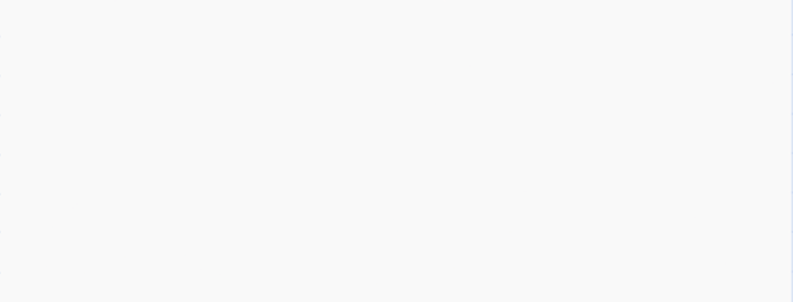

Team Members
Team Lead:
Email:
Phone:
Member 1:
Email:
Phone:
Member 2 (Optional):
Email:
Phone:
Member 3 (Optional):
Email:
Phone:
Bey
ndBYTE
IDEATHON & HACKATHON

Slide 8



Bey
ndBYTE
IDEATHON & HACKATHON
Rhea | +91 63638 03411
Prianshu | +91 88991 45658
INSTRUCTION: You can remove this during Submission!

